Slide 1
Description of Analytic Sample

Slide 2
 |  | 2009 Descriptive Statistics |  | 2019 Descriptive Statistics
Variable |  | 2009 only (N = 4,085) | Both years in 2009 and 2019 (N = 4,617) | 2019 only (N = 3,312) | Both years in 2009 and 2019 (N = 4,617)
Age - Mean (std) |  | 47.9 (12.3) | 45.3 (9.2) | 40.8 (10.9) | 55.3 (9.2)
Age | 35 and below | 19% (N = 792) | 15% (N = 697) | 39% (N = 1302) | 0% (N = 0)
 | 36 to 45 | 27% (N = 1108) | 39% (N = 1796) | 36% (N = 1198) | 15% (N = 697)
 | 46 to 55 | 24% (N = 981) | 32% (N = 1462) | 13% (N = 415) | 39% (N = 1796)
 | 56 to 65 | 21% (N = 866) | 12% (N = 575) | 8% (N = 254) | 32% (N = 1462)
 | 66 + | 8% (N = 338) | 2% (N = 87) | 4% (N = 143) | 14% (N = 662)
% Female |  | 35% (N = 1448) | 43% (N = 1985) | 60% (N = 1984) | 43% (N = 1985)
Racial/ethnic identity | Non-Hispanic White | 71% (N = 2903) | 73% (N = 3356) | 60% (N = 1996) | 73% (N = 3356)
 | Non-Hispanic Black | 10% (N = 404) | 11% (N = 521) | 11% (N = 378) | 11% (N = 521)
 | American Indian/Alaskan Native | 1% (N = 26) | 1% (N = 34) | 0% (N = 14) | 1% (N = 34)
 | Asian/Pacific Islander | 11% (N = 432) | 9% (N = 427) | 12% (N = 408) | 9% (N = 427)
 | Hispanic | 3% (N = 140) | 4% (N = 164) | 5% (N = 157) | 4% (N = 164)
 | Other | 4% (N = 152) | 2% (N = 105) | 3% (N = 102) | 2% (N = 105)
 | Unknown | 1% (N = 28) | 0% (N = 10) | 8% (N = 257) | 0% (N = 10)
Generational Cohort | WWII (1928-1945) | 13% (N = 513) | 3% (N = 152) | 2% (N = 50) | 3% (N = 152)
 | Baby boomer, leading edge (1946-1954) | 22% (N = 916) | 17% (N = 784) | 4% (N = 127) | 17% (N = 784)
 | Baby boomer, trailing edge (1955-1964) | 23% (N = 947) | 33% (N = 1514) | 8% (N = 276) | 33% (N = 1514)
 | Gen X (1965-1980) | 42% (N = 1701) | 47% (N = 2166) | 35% (N = 1174) | 47% (N = 2166)
 | Gen Y (1981-2000) | 0% (N = 8) | 0% (N = 1) | 51% (N = 1685) | 0% (N = 1)

Slide 3
 |  | 2009 Descriptive Statistics |  | 2019 Descriptive Statistics
Variable |  | 2009 only (N = 4,085) | Both years in 2009 and 2019 (N = 4,617) | 2019 only (N = 3,312) | Both years in 2009 and 2019 (N = 4,617)
Specialty | Family Medicine | 27% (N = 1115) | 37% (N = 1714) | 35% (N = 1169) | 36% (N = 1658)
 | Geriatrics | 0% (N = 12) | 1% (N = 30) | 3% (N = 98) | 3% (N = 152)
 | General internal medicine | 44% (N = 1803) | 27% (N = 1268) | 27% (N = 889) | 25% (N = 1173)
 | General obstetrics and gynecology | 11% (N = 457) | 15% (N = 670) | 15% (N = 496) | 14% (N = 665)
 | General pediatrics | 17% (N = 698) | 20% (N = 932) | 20% (N = 660) | 21% (N = 969)
Employment Setting | Ambulatory care | 38% (N = 1569) | 66% (N = 3037) | 44% (N = 1462) | 62% (N = 2844)
 | Hospital | 31% (N = 1261) | 11% (N = 489) | 28% (N = 941) | 11% (N = 502)
 | Medical school/parent university | 12% (N = 474) | 4% (N = 174) | 3% (N = 102) | 3% (N = 138)
 | Nursing home/extended care | 1% (N = 30) | 1% (N = 42) | 1% (N = 46) | 2% (N = 77)
 | Other | 2% (N = 80) | 1% (N = 33) | 9% (N = 296) | 8% (N = 382)
 | Solo practitioner | 9% (N = 358) | 13% (N = 605) | 2% (N = 82) | 10% (N = 484)
 | Missing | 8% (N = 313) | 5% (N = 237) | 12% (N = 383) | 4% (N = 190)
Practice characteristics | Providing routine prenatal care | 10% (N = 380) | 16% (N = 730) | 19% (N = 577) | 13% (N = 590)
 | Providing routine obstetric deliveries | 7% (N = 276) | 13% (N = 592) | 16% (N = 474) | 10% (N = 477)
Urban/rural status | Urban | 80% (N = 3279) | 81% (N = 3723) | 86% (N = 2824) | 82% (N = 3783)
 | Large rural | 14% (N = 561) | 14% (N = 641) | 11% (N = 348) | 13% (N = 596)
 | Small rural | 6% (N = 245) | 5% (N = 253) | 4% (N = 130) | 5% (N = 237)

Slide 4
 |  | 2009 Descriptive Statistics |  | 2019 Descriptive Statistics
Variable |  | 2009 only (N = 4,085) | Both years in 2009 and 2019 (N = 4,617) | 2019 only (N = 3,312) | Both years in 2009 and 2019 (N = 4,617)
Average years of practice (STD) |  | 21.3 (12.4) | 18.8 (9.3) | 13.7 (10.8) | 28.8 (9.3)
Avg patient-care hours per week |  | 39.3 (16.6) | 41.9 (13.9) | 38.1 (15.4) | 38.5 (15.4)
Years Since Medical School | 0 to 5 | 8% (N = 318) | 6% (N = 268) | 22% (N = 735) | 0% (N = 0)
 | 6 to 10 | 17% (N = 688) | 15% (N = 703) | 29% (N = 967) | 0% (N = 0)
 | 11 to 20 | 26% (N = 1075) | 39% (N = 1808) | 27% (N = 908) | 21% (N = 971)
 | 21 to 30 | 24% (N = 980) | 28% (N = 1283) | 11% (N = 376) | 39% (N = 1808)
 | 31 + | 25% (N = 1008) | 12% (N = 553) | 10% (N = 324) | 40% (N = 1836)
ADI - State |  | 4.8 (3) | 4.6 (3) | 4.4 (3) | 4.5 (3)
HPSA | Full HSPA | 5% (N = 217) | 5% (N = 243) | 5% (N = 158) | 5% (N = 233)
 | Not HPSA | 3% (N = 140) | 3% (N = 156) | 3% (N = 110) | 4% (N = 167)
 | Part HPSA | 91% (N = 3728) | 91% (N = 4218) | 92% (N = 3034) | 91% (N = 4217)
Medical school | school_img | 20% (N = 797) | 14% (N = 658) | 17% (N = 568) | 14% (N = 646)
 | school_in_state | 24% (N = 956) | 33% (N = 1504) | 21% (N = 694) | 33% (N = 1501)
 | school_out_hbcu | 1% (N = 60) | 2% (N = 70) | 2% (N = 52) | 2% (N = 70)
 | school_out_nonhbcu | 55% (N = 2224) | 52% (N = 2385) | 60% (N = 1995) | 52% (N = 2400)

Slide 5
Race/ethnicity matches exactly between 2009 and 2019
 | Non-Hispanic White in 2019 | Non-Hispanic Black in 2019 | American Indian/Alaskan Native in 2019 | Asian/Pacific Islander in 2019 | Hispanic in 2019 | Other in 2019 | Unknown in 2019 | 2009 Total
Non-Hispanic White in 2009 | 3356 | 0 | 0 | 0 | 0 | 0 | 0 | 3356
Non-Hispanic Black in 2009 | 0 | 521 | 0 | 0 | 0 | 0 | 0 | 521
American Indian/Alaskan Native in 2009 | 0 | 0 | 34 | 0 | 0 | 0 | 0 | 34
Asian/Pacific Islander in 2009 | 0 | 0 | 0 | 427 | 0 | 0 | 0 | 427
Hispanic in 2009 | 0 | 0 | 0 | 0 | 164 | 0 | 0 | 164
Other in 2009 | 0 | 0 | 0 | 0 | 0 | 105 | 0 | 105
Unknown in 2009 | 0 | 0 | 0 | 0 | 0 | 0 | 10 | 10
2019 Total | 3356 | 521 | 34 | 427 | 164 | 105 | 10 | 4617

Slide 6
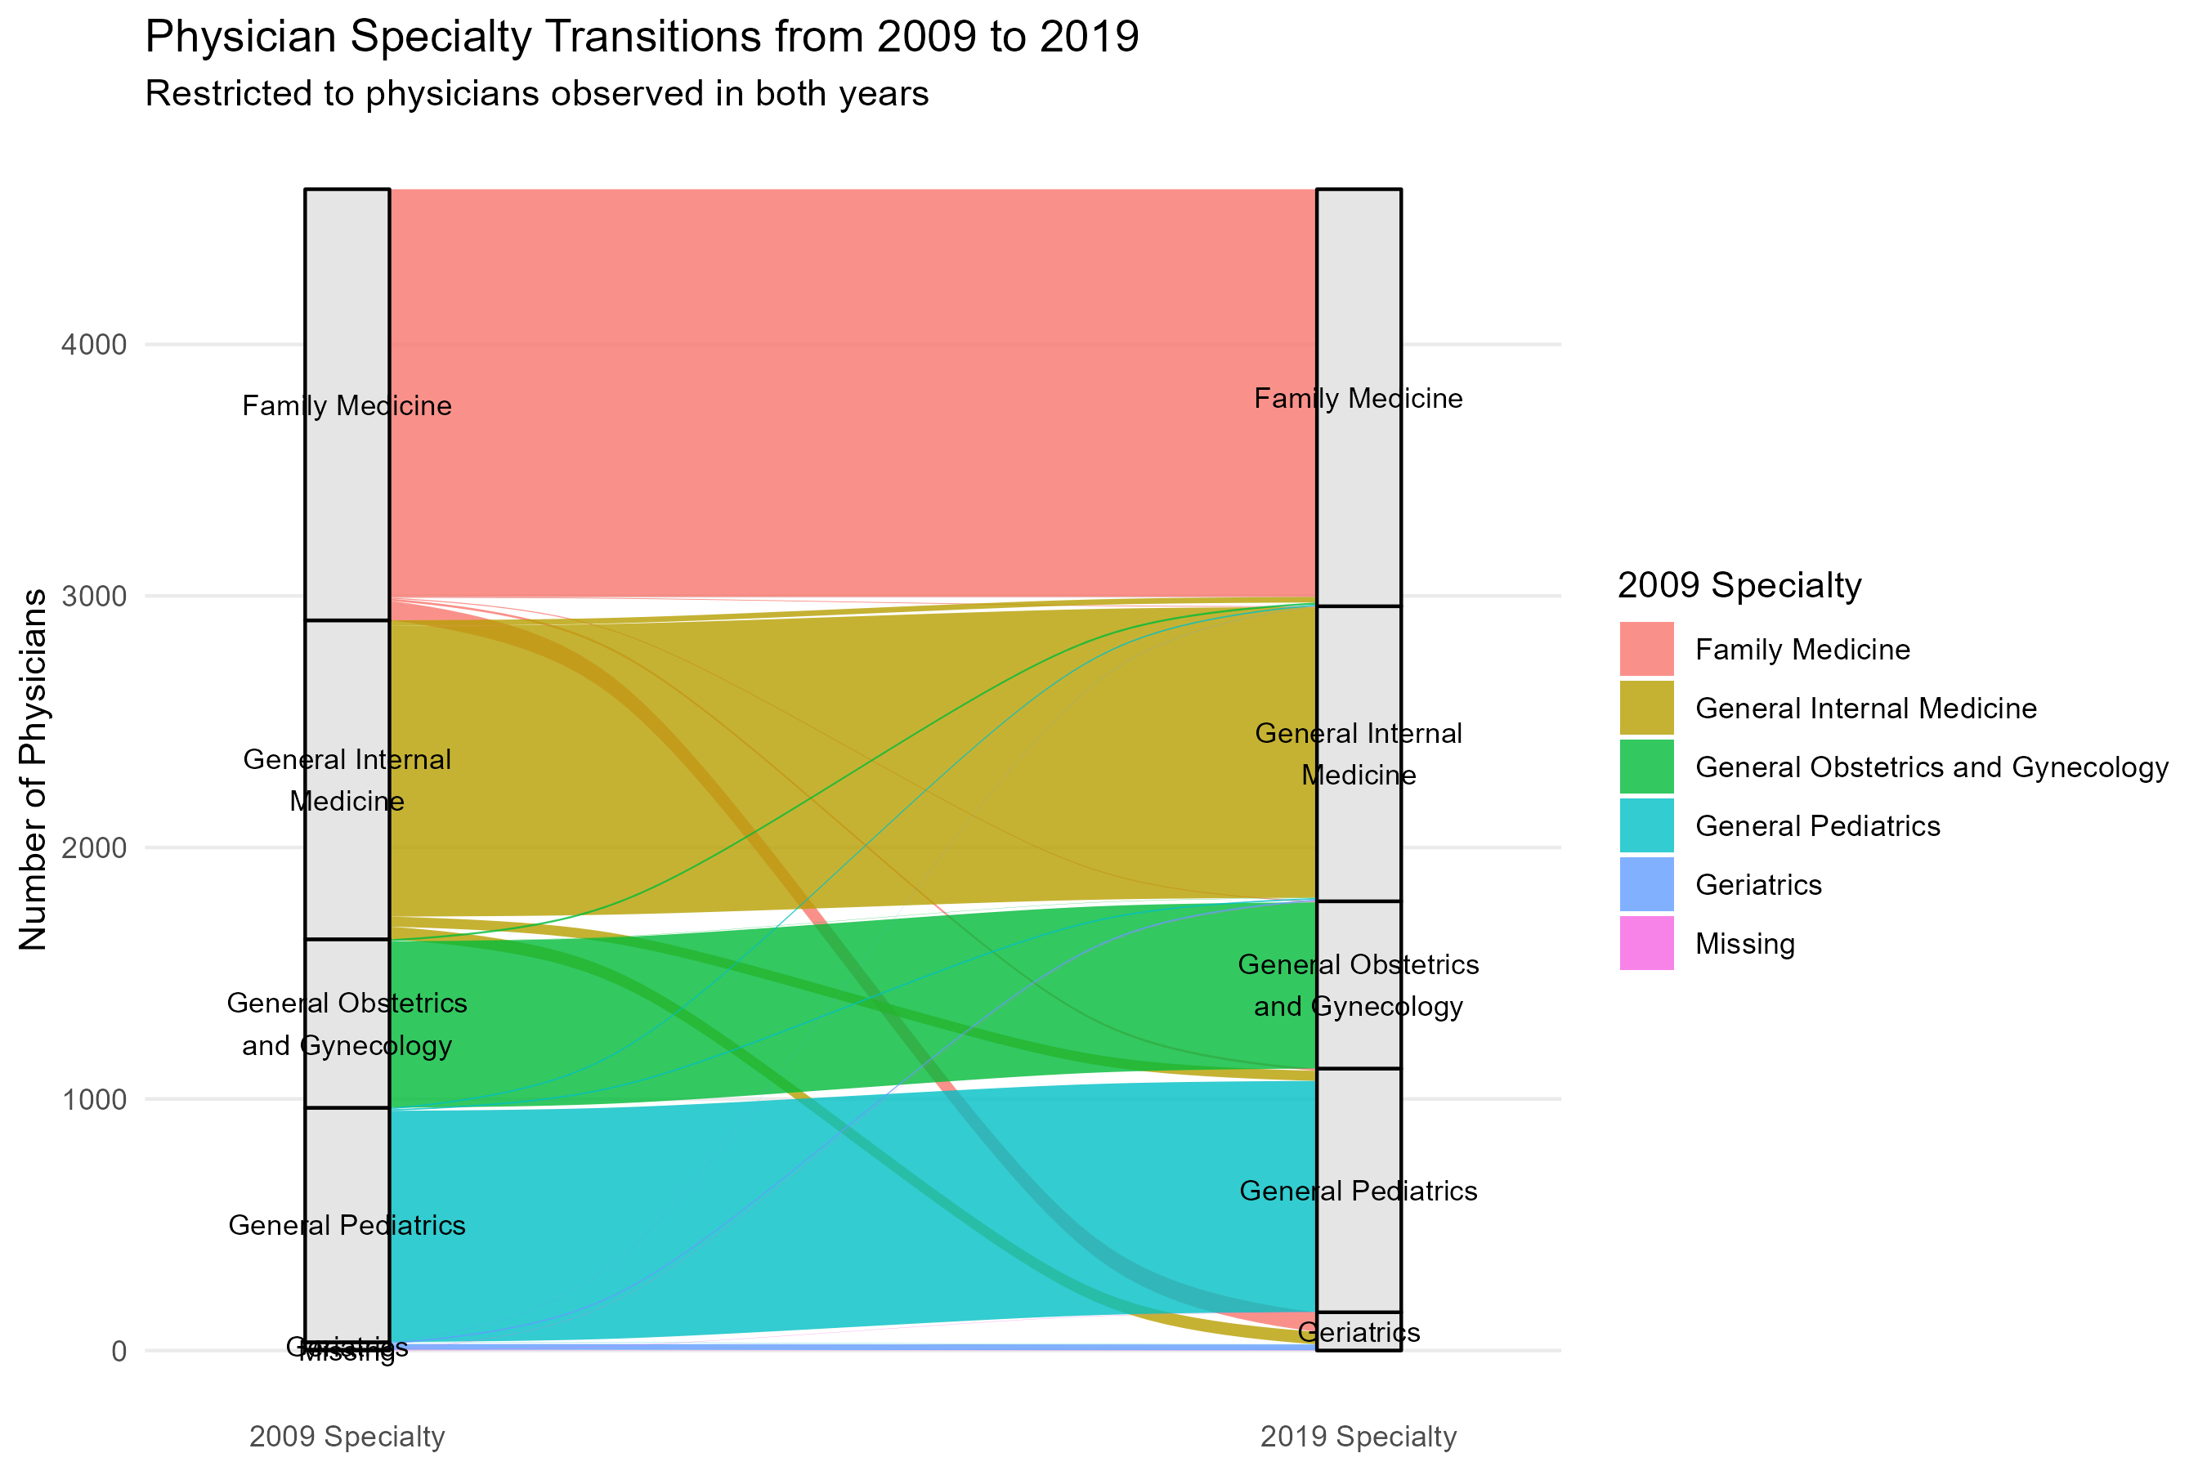

Slide 7
Specialty Transitions
 | Family Medicine in 2019 | General Internal Medicine in 2019 | General Obstetrics and Gynecology in 2019 | General Pediatrics in 2019 | Geriatrics in 2019 | Missing in 2019 | 2009 Total
Family Medicine in 2009 | 1621 | 3 | 4 | 9 | 77 | 0 | 1714
General Internal Medicine in 2009 | 22 | 1156 | 0 | 40 | 50 | 0 | 1268
General Obstetrics and Gynecology in 2009 | 8 | 1 | 661 | 0 | 0 | 0 | 670
General Pediatrics in 2009 | 6 | 6 | 0 | 919 | 1 | 0 | 932
Geriatrics in 2009 | 1 | 6 | 0 | 0 | 23 | 0 | 30
Missing in 2009 | 0 | 1 | 0 | 1 | 1 | 0 | 3
2019 Total | 1658 | 1173 | 665 | 969 | 152 | 0 | 4617

Slide 8
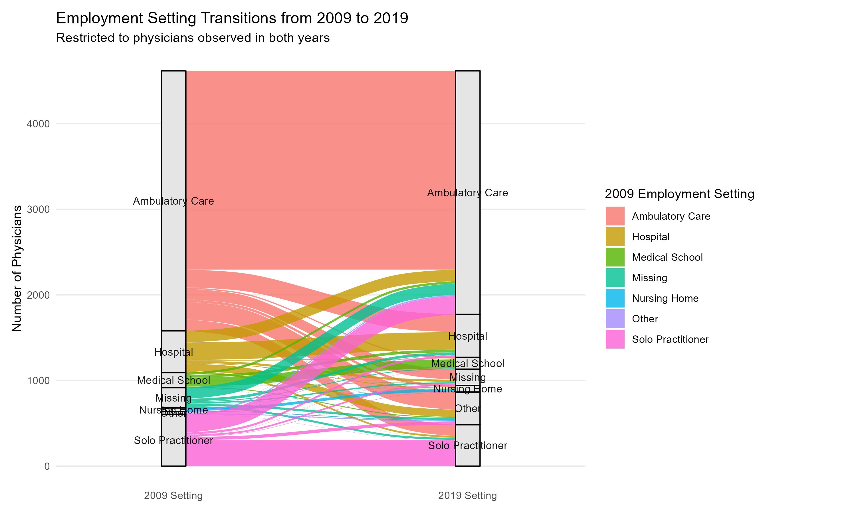

Slide 9
Employment Setting Transitions
 | Ambulatory Care in 2019 | Hospital in 2019 | Medical School in 2019 | Nursing Home in 2019 | Solo Practitioner in 2019 | Other in 2019 | Missing in 2019 | 2009 Total
Ambulatory Care in 2009 | 2321 | 208 | 15 | 29 | 133 | 207 | 124 | 3037
Hospital in 2009 | 135 | 204 | 10 | 8 | 21 | 86 | 25 | 489
Medical School in 2009 | 26 | 31 | 102 | 1 | 1 | 10 | 3 | 174
Nursing Home in 2009 | 2 | 0 | 0 | 32 | 0 | 7 | 1 | 42
Solo Practitioner in 2009 | 214 | 24 | 2 | 4 | 304 | 37 | 20 | 605
Other in 2009 | 14 | 5 | 0 | 0 | 2 | 10 | 2 | 33
Missing in 2009 | 132 | 30 | 9 | 3 | 23 | 25 | 15 | 237
2019 Total | 2844 | 502 | 138 | 77 | 484 | 382 | 190 | 4617

Slide 10
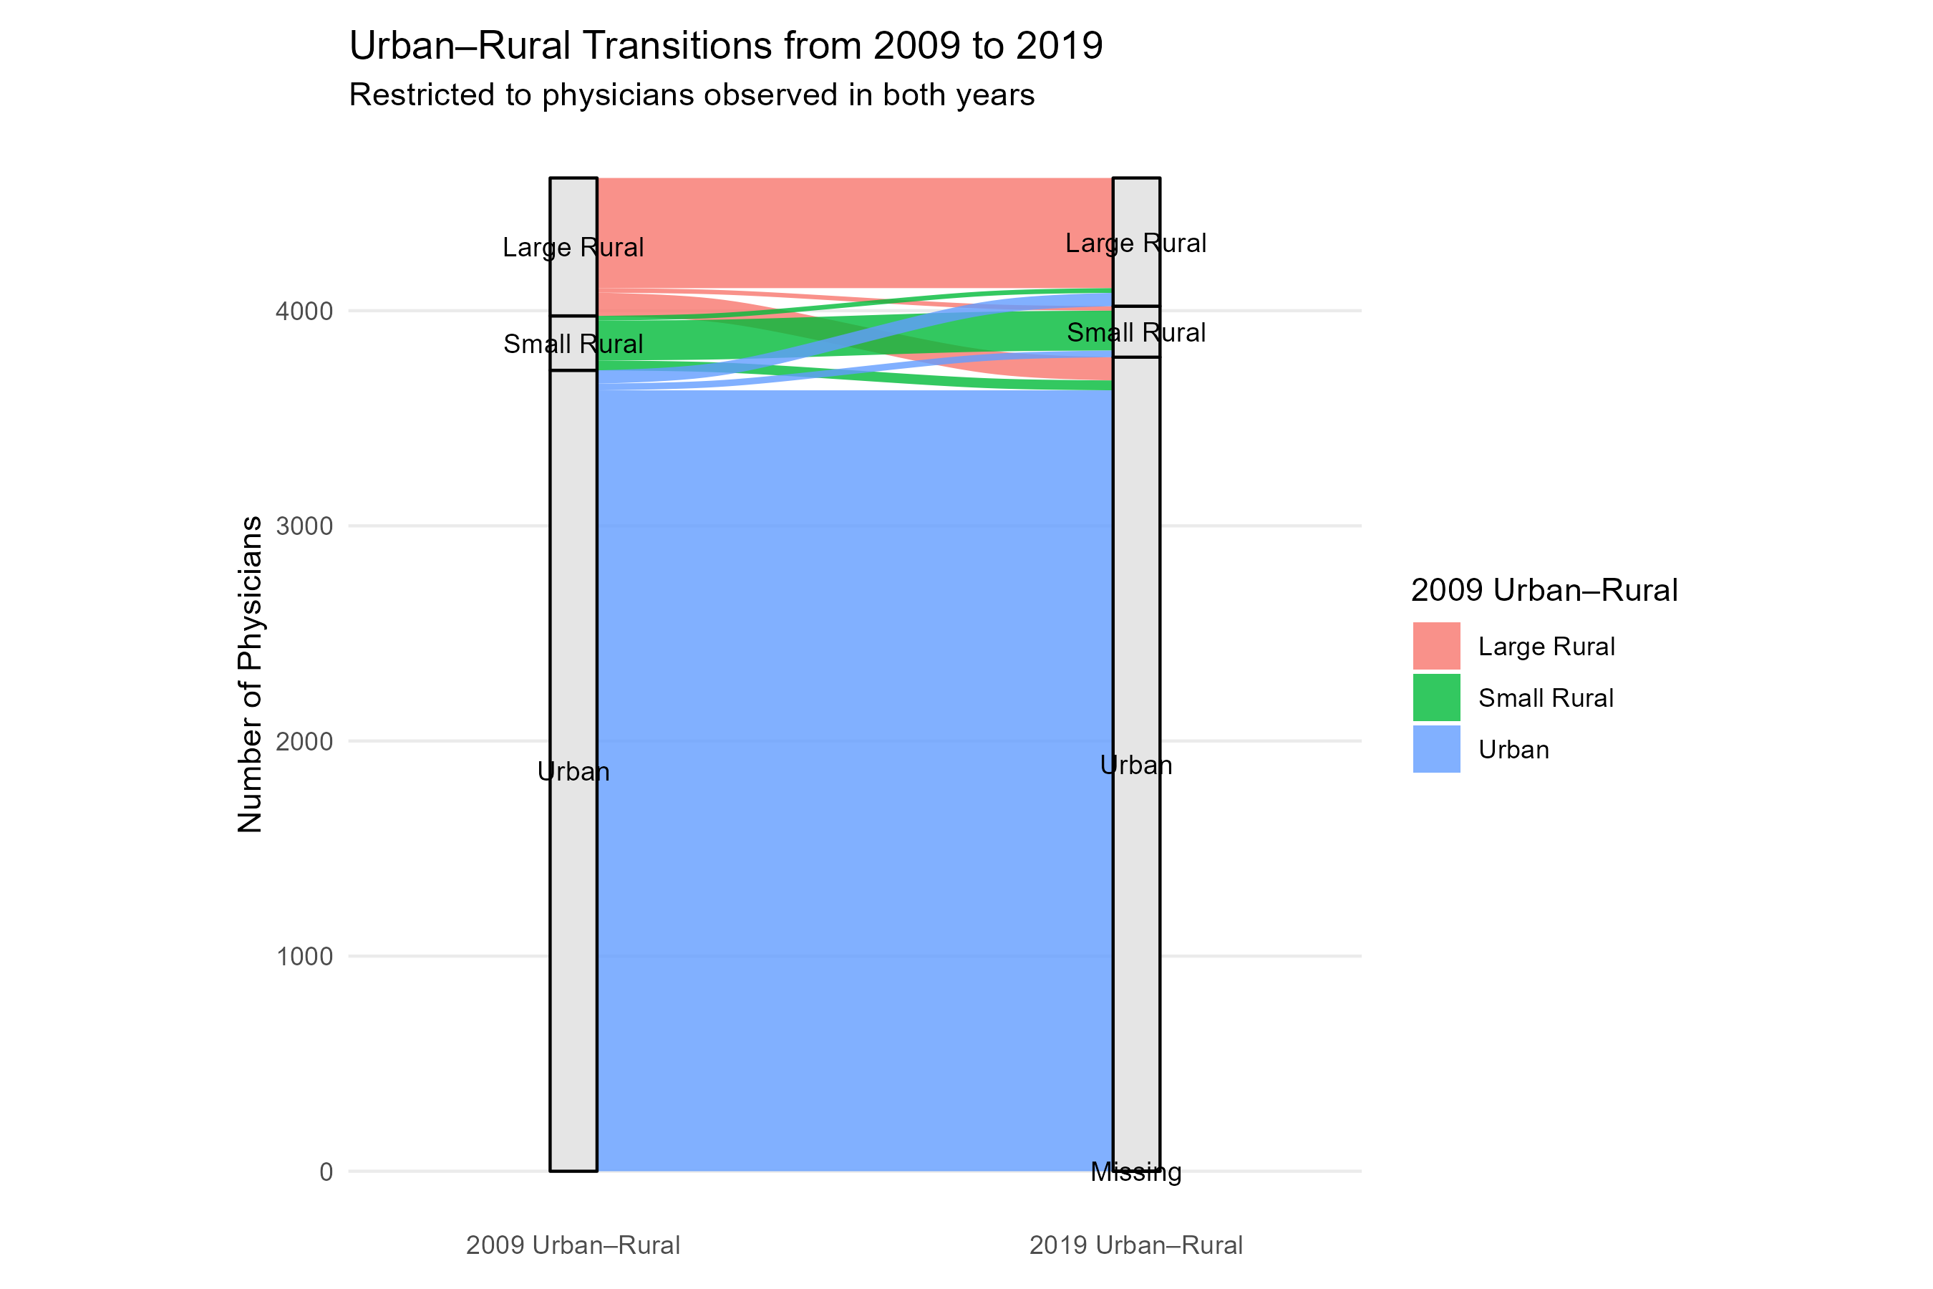

Slide 11
Urban/Rural Status Transitions
 | Urban in 2019 | Large Rural in 2019 | Small Rural in 2019 | Missing in 2019 | 2009 Total
Urban in 2009 | 3629 | 62 | 31 | 1 | 3723
Large Rural in 2009 | 108 | 512 | 21 | 0 | 641
Small Rural in 2009 | 46 | 22 | 185 | 0 | 253
Missing in 2009 | 0 | 0 | 0 | 0 | 0
2019 Total | 3783 | 596 | 237 | 1 | 4617

Slide 12
Latent Class Transition Analysis

Slide 13
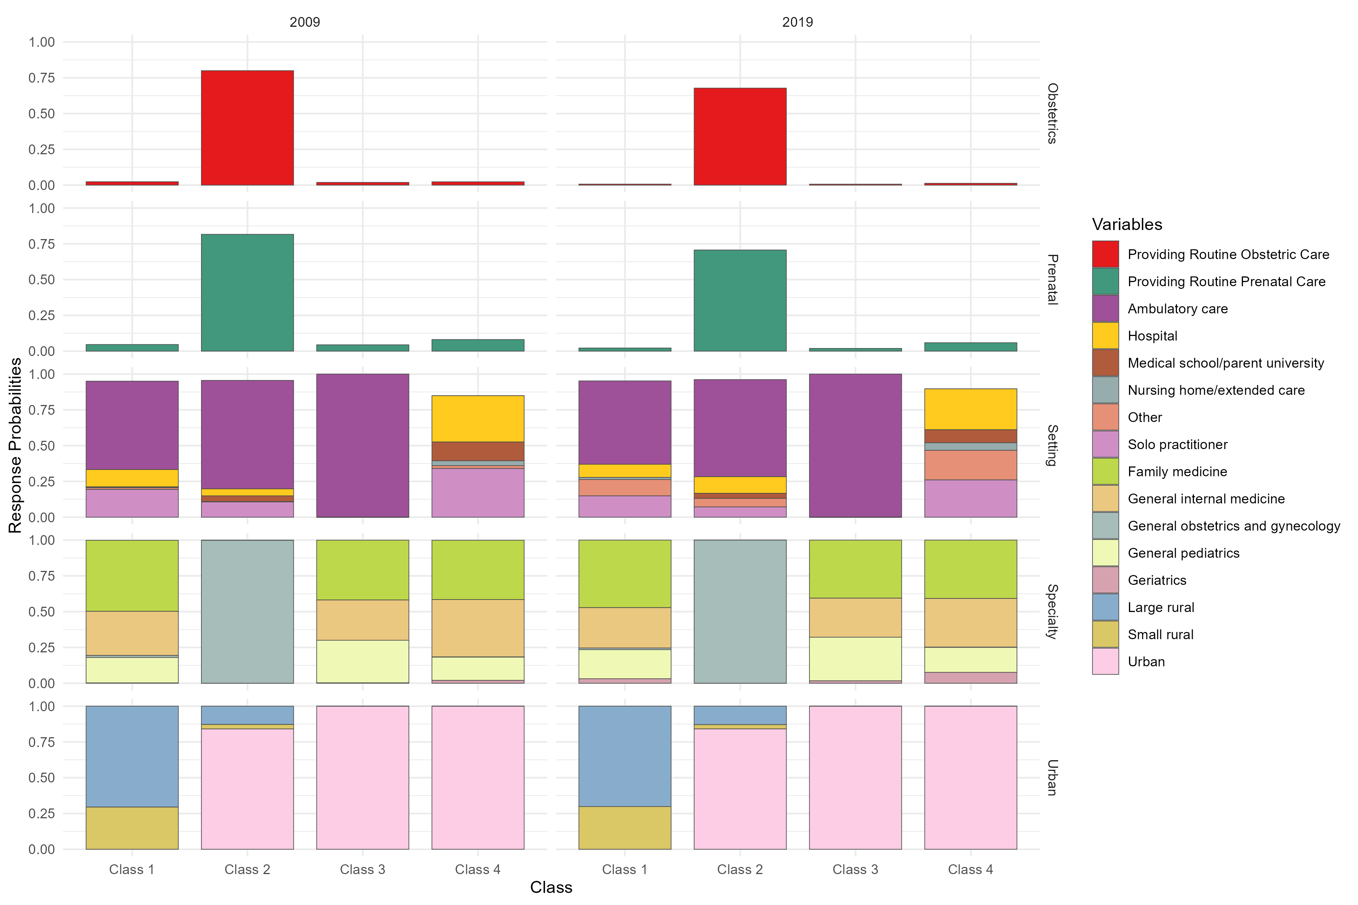

Slide 14
Descriptive Stats by Latent Class in 2009

Slide 15
Variable |  | Class 1 - Rural PCPs in 2009 | Class 2 - Ob-gyns (but no family medicine) in 2009 | Class 3 - Urban ambulatory care PCPs in 2009 | Class 4 Urban, non-ambulatory care PCPs in 2009
Total N |  | N = 791 | N = 656 | N = 2,051 | N = 1119
Age - Mean (std) |  | 47.4 (9.6) | 44.9 (9) | 44 (8.6) | 46.4 (9.7)
Age | 35 and below | 12% (N = 98) | 15% (N = 96) | 16% (N = 338) | 15% (N = 165)
 | 36 to 45 | 32% (N = 250) | 42% (N = 276) | 44% (N = 895) | 34% (N = 375)
 | 46 to 55 | 36% (N = 281) | 30% (N = 199) | 30% (N = 610) | 33% (N = 372)
 | 56 to 65 | 18% (N = 139) | 11% (N = 71) | 9% (N = 190) | 16% (N = 175)
 | 66 + | 3% (N = 23) | 2% (N = 14) | 1% (N = 18) | 3% (N = 32)
% Female |  | 34% (N = 266) | 50% (N = 331) | 45% (N = 926) | 41% (N = 462)
Racial/ethnic identity | Non-Hispanic White | 70% (N = 556) | 79% (N = 516) | 76% (N = 1569) | 64% (N = 715)
 | Non-Hispanic Black | 10% (N = 82) | 13% (N = 83) | 9% (N = 189) | 15% (N = 167)
 | American Indian/Alaskan Native | 2% (N = 15) | 1% (N = 6) | 0% (N = 10) | 0% (N = 3)
 | Asian/Pacific Islander | 10% (N = 79) | 4% (N = 24) | 9% (N = 175) | 13% (N = 149)
 | Hispanic | 4% (N = 33) | 3% (N = 22) | 3% (N = 54) | 5% (N = 55)
 | Other | 3% (N = 24) | 1% (N = 4) | 2% (N = 49) | 3% (N = 28)
 | Unknown | 0% (N = 2) | 0% (N = 1) | 0% (N = 5) | 0% (N = 2)
Generational Cohort | WWII (1928-1945) | 4% (N = 35) | 3% (N = 21) | 2% (N = 45) | 5% (N = 51)
 | Baby boomer, leading edge (1946-1954) | 24% (N = 190) | 15% (N = 99) | 13% (N = 268) | 20% (N = 227)
 | Baby boomer, trailing edge (1955-1964) | 34% (N = 265) | 32% (N = 208) | 32% (N = 659) | 34% (N = 382)
 | Gen X (1965-1980) | 38% (N = 301) | 50% (N = 328) | 53% (N = 1078) | 41% (N = 459)
 | Gen Y (1981-2000) | 0% (N = 0) | 0% (N = 0) | 0% (N = 1) | 0% (N = 0)

Slide 16
Variable |  | Class 1 - Rural PCPs in 2009 | Class 2 - Ob-gyns (but no family medicine) in 2009 | Class 3 - Urban ambulatory care PCPs in 2009 | Class 4 Urban, non-ambulatory care PCPs in 2009
Total N |  | N = 791 | N = 656 | N = 2,051 | N = 1119
Average years of practice (STD) |  | 20.3 (9.8) | 18.4 (8.9) | 17.6 (8.8) | 20 (10)
Avg patient-care hours per week |  | 44.9 (13.4) | 47.8 (15.2) | 40 (11.5) | 39.8 (16.3)
Years Since Medical School | 0 to 5 | 4% (N = 34) | 5% (N = 33) | 6% (N = 132) | 6% (N = 69)
 | 6 to 10 | 14% (N = 107) | 15% (N = 99) | 17% (N = 346) | 14% (N = 151)
 | 11 to 20 | 35% (N = 280) | 43% (N = 280) | 42% (N = 866) | 34% (N = 382)
 | 21 to 30 | 30% (N = 235) | 27% (N = 180) | 26% (N = 533) | 30% (N = 335)
 | 31 + | 17% (N = 135) | 10% (N = 64) | 8% (N = 173) | 16% (N = 181)
ADI - State |  | 6.6 (2.6) | 4.3 (3) | 4.1 (2.8) | 4.5 (2.9)
HPSA | Full HSPA | 17% (N = 134) | 4% (N = 26) | 2% (N = 45) | 3% (N = 38)
 | Not HPSA | 9% (N = 72) | 3% (N = 19) | 2% (N = 47) | 2% (N = 18)
 | Part HPSA | 74% (N = 585) | 93% (N = 611) | 96% (N = 1959) | 95% (N = 1063)
Medical school | IMG | 20% (N = 160) | 3% (N = 20) | 10% (N = 214) | 24% (N = 264)
 | In State | 33% (N = 261) | 37% (N = 243) | 35% (N = 722) | 25% (N = 278)
 | Out of State - HBCU | 2% (N = 12) | 2% (N = 10) | 1% (N = 21) | 2% (N = 27)
 | Out of State - Non-HBCU | 45% (N = 358) | 58% (N = 383) | 53% (N = 1094) | 49% (N = 550)

Slide 17
Descriptive Stats by Latent Class in 2019

Slide 18
Variable |  | Class 1 - Rural PCPs in 2019 | Class 2 - Ob-gyns (but no family medicine) in 2019 | Class 3 - Urban ambulatory care PCPs in 2019 | Class 4 Urban, non-ambulatory care PCPs in 2019
Total N |  | N = 731 | N = 653 | N = 1975 | N = 1258
Age - Mean (std) |  | 58 (9.3) | 54.9 (9) | 53.9 (8.6) | 56.1 (9.7)
Age | 35 and below | 0% (N = 0) | 0% (N = 0) | 0% (N = 0) | 0% (N = 0)
 | 36 to 45 | 10% (N = 76) | 15% (N = 96) | 17% (N = 334) | 15% (N = 191)
 | 46 to 55 | 31% (N = 226) | 42% (N = 275) | 44% (N = 863) | 34% (N = 432)
 | 56 to 65 | 37% (N = 274) | 30% (N = 198) | 29% (N = 576) | 33% (N = 414)
 | 66 + | 21% (N = 155) | 13% (N = 84) | 10% (N = 202) | 18% (N = 221)
% Female |  | 32% (N = 234) | 50% (N = 329) | 43% (N = 851) | 45% (N = 571)
Racial/ethnic identity | Non-Hispanic White
 | Non-Hispanic Black | 10% (N = 75) | 13% (N = 83) | 9% (N = 176) | 15% (N = 187)
 | American Indian/Alaskan Native | 2% (N = 14) | 1% (N = 6) | 0% (N = 8) | 0% (N = 6)
 | Asian/Pacific Islander | 9% (N = 65) | 4% (N = 24) | 9% (N = 171) | 13% (N = 167)
 | Hispanic | 4% (N = 29) | 3% (N = 21) | 3% (N = 58) | 4% (N = 56)
 | Other | 3% (N = 24) | 1% (N = 4) | 2% (N = 44) | 3% (N = 33)
 | Unknown | 0% (N = 1) | 0% (N = 1) | 0% (N = 5) | 0% (N = 3)
Generational Cohort | WWII (1928-1945) | 5% (N = 33) | 3% (N = 20) | 2% (N = 39) | 5% (N = 60)
 | Baby boomer, leading edge (1946-1954) | 25% (N = 181) | 15% (N = 99) | 13% (N = 258) | 20% (N = 246)
 | Baby boomer, trailing edge (1955-1964) | 35% (N = 257) | 32% (N = 207) | 32% (N = 635) | 33% (N = 415)
 | Gen X (1965-1980) | 36% (N = 260) | 50% (N = 327) | 53% (N = 1042) | 43% (N = 537)
 | Gen Y (1981-2000) | 0% (N = 0) | 0% (N = 0) | 0% (N = 1) | 0% (N = 0)

Slide 19
Variable |  | Class 1 - Rural PCPs in 2019 | Class 2 - Ob-gyns (but no family medicine) in 2019 | Class 3 - Urban ambulatory care PCPs in 2019 | Class 4 Urban, non-ambulatory care PCPs in 2019
Total N |  | N = 731 | N = 653 | N = 1975 | N = 1258
Average years of practice (STD) |  | 30.9 (9.6) | 28.4 (8.9) | 27.5 (8.8) | 29.6 (10)
Avg patient-care hours per week |  | 40.1 (14.8) | 42.7 (17.5) | 39.5 (13.1) | 33.9 (16.8)
Years Since Medical School | 0 to 5 | 0% (N = 0) | 0% (N = 0) | 0% (N = 0) | 0% (N = 0)
 | 6 to 10 | 0% (N = 0) | 0% (N = 0) | 0% (N = 0) | 0% (N = 0)
 | 11 to 20 | 15% (N = 109) | 20% (N = 131) | 23% (N = 462) | 21% (N = 269)
 | 21 to 30 | 35% (N = 258) | 43% (N = 279) | 42% (N = 833) | 35% (N = 438)
 | 31 + | 50% (N = 364) | 37% (N = 243) | 34% (N = 679) | 44% (N = 550)
ADI - State |  | 6.5 (2.7) | 4.2 (2.9) | 3.8 (2.8) | 4.5 (3)
HPSA | Full HSPA | 17% (N = 124) | 4% (N = 25) | 2% (N = 46) | 3% (N = 38)
 | Not HPSA | 10% (N = 71) | 3% (N = 17) | 2% (N = 48) | 2% (N = 31)
 | Part HPSA | 73% (N = 536) | 94% (N = 611) | 95% (N = 1881) | 95% (N = 1189)
Medical school | IMG | 18% (N = 133) | 3% (N = 20) | 12% (N = 234) | 21% (N = 259)
 | In State | 34% (N = 250) | 37% (N = 241) | 34% (N = 672) | 27% (N = 338)
 | Out of State - HBCU | 2% (N = 11) | 2% (N = 10) | 1% (N = 18) | 2% (N = 31)
 | Out of State - Non-HBCU | 46% (N = 337) | 58% (N = 382) | 53% (N = 1051) | 50% (N = 630)

Slide 20
Transitions Between Latent Classes

Slide 21
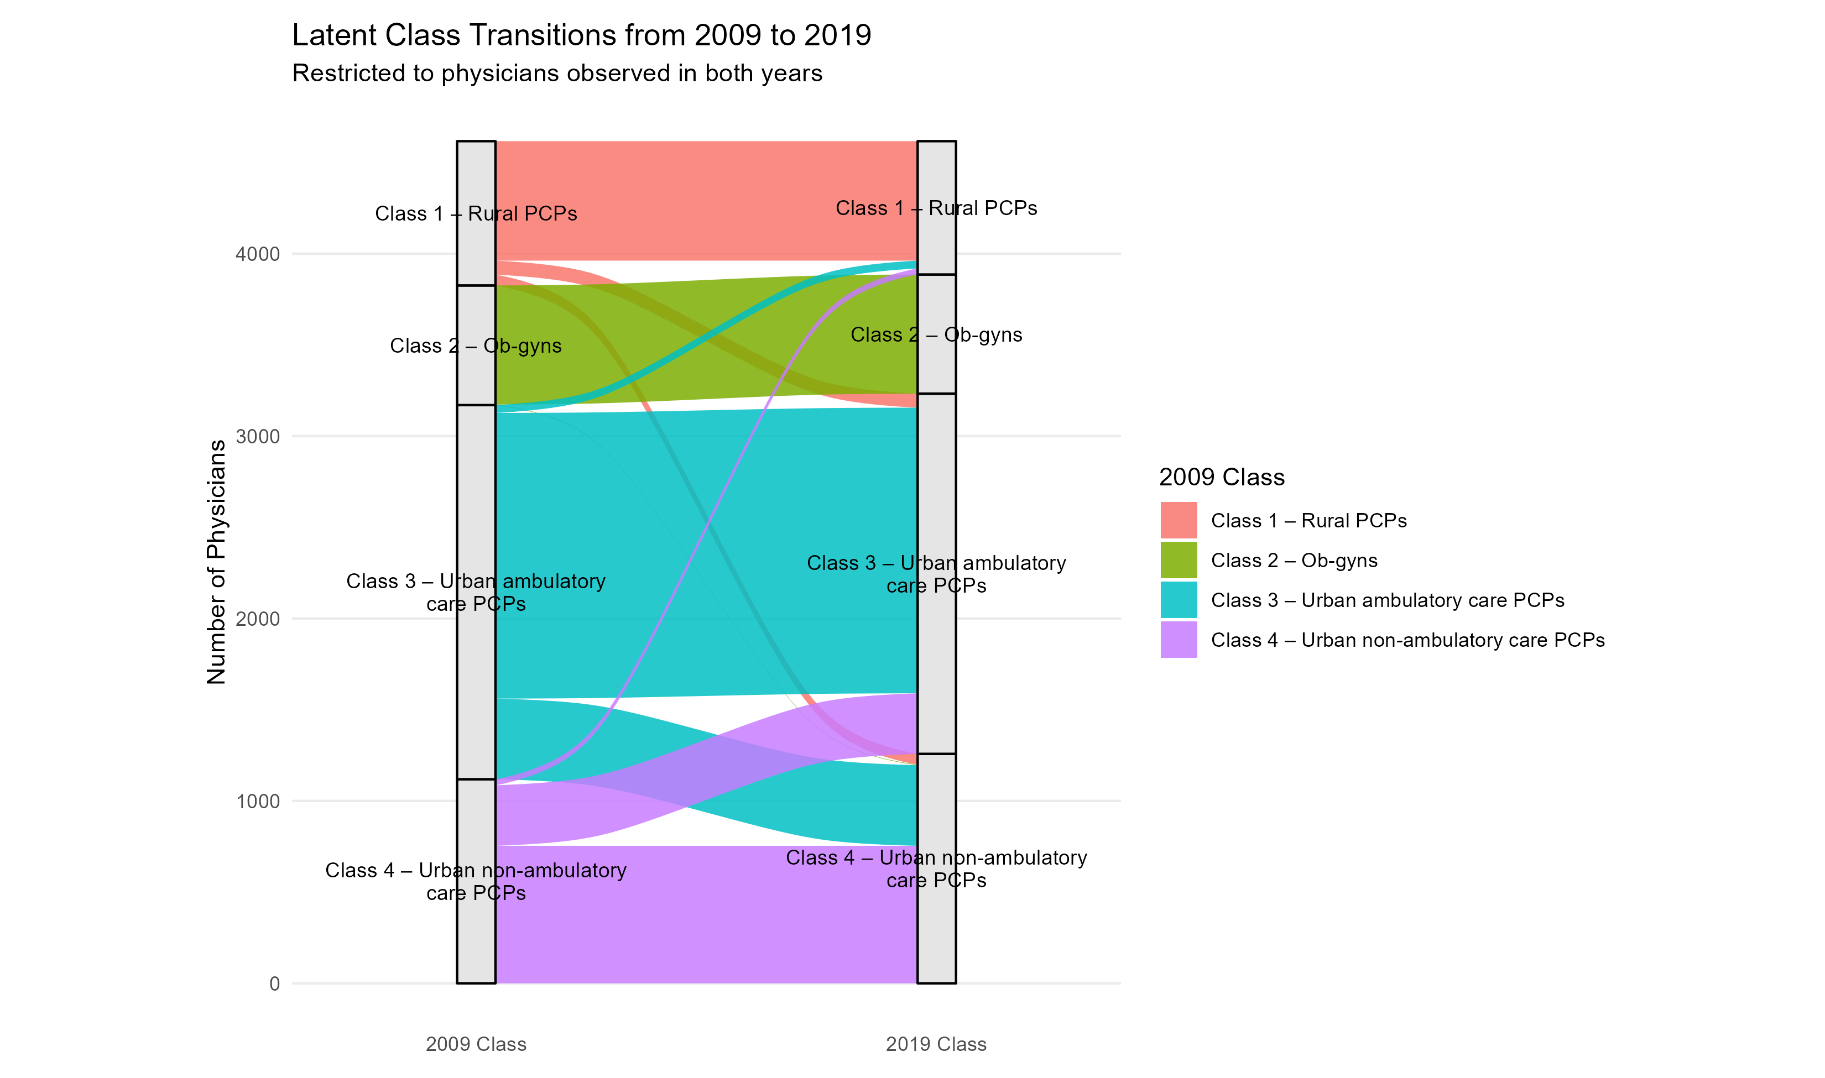

Slide 22
Latent Class Transitions
 | Class 1 - Rural PCPs in 2019 | Class 2 - Ob-gyns (but no family medicine) in 2019 | Class 3 - Urban ambulatory care PCPs in 2019 | Class 4 Urban, non-ambulatory care PCPs in 2019 | 2009 Total
Class 1 - Rural PCPs in 2009 | 655 | 0 | 77 | 59 | 791
Class 2 - Ob-gyns (but no family medicine) in 2009 | 0 | 653 | 0 | 3 | 656
Class 3 - Urban ambulatory care PCPs in 2009 | 43 | 0 | 1566 | 442 | 2051
Class 4 Urban, non-ambulatory care PCPs in 2009 | 33 | 0 | 332 | 754 | 1119
2009 Total | 731 | 653 | 1975 | 1258 | 4617

